Slide 1

Analysis of Variance
Presented by:
Elizer Ponio Jr.
Department of Computer Science
College of Computing and Information Technologies

Slide 2
Outline
What is Analysis of Variance?
Parts of a Significance Tests

Slide 3
Recap: T-test
The t-test tells you how significant the differences between group means are.
It lets you know if those differences in means could have happened by chance.
The t-test is usually used when data sets follow a normal distribution but you don’t know the population variance.

Slide 4
Analysis of Variance
Analysis of Variance or ANOVA is a statistical test to find out if a survey or experiment results are significant.
ANOVA helps you to figure out if you need to reject the null hypothesis or accept the alternate hypothesis.

Slide 5
Analysis of Variance Examples
Basically, you’re testing groups to see if there’s a difference between them. Examples of when you might want to test different groups:

Slide 6



Analysis of Variance
A group of psychiatric patients are trying three different therapies: counseling, medication and biofeedback. You want to see if one therapy is better than the others.

Slide 7

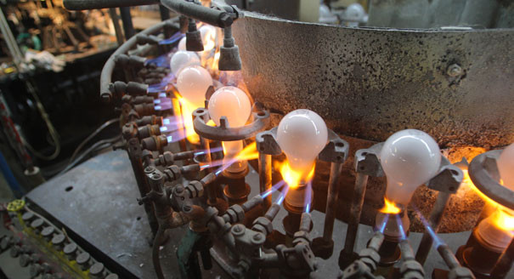
Analysis of Variance
A manufacturer has two different processes to make light bulbs. They want to know if one process is better than the other.

Slide 8


Analysis of Variance
Students from different colleges take the same exam. You want to see if if students who study alone outperforms students who studied in a group.

Slide 9
ANOVA vs T test
Descriptive | Inferential
ANOVA can compare three or more groups while | T tests are only useful for comparing two groups at one time.
ANOVA compares variances between populations | T test will tell you if there is a significant variation between groups
ANOVA will give you a single number (f-statistic) and one (p-value) to help you support or reject the null hypothesis | In T test, as the groups grow in number, you may end up with a lot of pair comparisons that you need to run

Slide 10



Analysis of Variance Examples
Water | Juice | Coffee
10 | 11 | 12
12 | 14 | 13
18 | 19 | 17
24 | 23 | 25
36 | 38 | 37
For example, we have a dataset that shows the reaction time of different people when taking either water, juice or coffee.
You gathered this data because you want to compare how effective drinking a coffee is when it comes to reaction time.

Slide 11

Analysis of Variance Examples
Water | Juice | Coffee
10 | 11 | 12
12 | 14 | 13
18 | 19 | 17
24 | 23 | 25
36 | 38 | 37
There is a lot of variation in each group. Some people have faster reaction times and other are slower

Slide 12
Analysis of Variance Examples
Water | Juice | Coffee
10 | 11 | 12
12 | 14 | 13
18 | 19 | 17
24 | 23 | 25
36 | 38 | 37
But each group looks pretty much the same. There is not much variation between each group.

Slide 13
Analysis of Variance Examples
Water | Juice | Coffee
10 | 11 | 12
12 | 14 | 13
18 | 19 | 17
24 | 23 | 25
36 | 38 | 37
You would conclude that most of the difference is due to the people and the type of drink did not make much of a difference
You would accept the null hypothesis that the type of drink does not an effect on a person’s reaction time.

Slide 14
Analysis of Variance Examples
Water | Juice | Coffee
29 | 17 | 10
29 | 18 | 11
30 | 19 | 12
31 | 19 | 12
31 | 20 | 13
In this case, all the scores within each group are close to one another. There is not much variation in each group

Slide 15
Analysis of Variance Examples
Water | Juice | Coffee
29 | 17 | 10
29 | 18 | 11
30 | 19 | 12
31 | 19 | 12
31 | 20 | 13
But each group are very different from one another . There is a lot of variation between the groups .

Slide 16
Analysis of Variance Examples
Water | Juice | Coffee
29 | 17 | 10
29 | 18 | 11
30 | 19 | 12
31 | 19 | 12
31 | 20 | 13
In this case, you would reject the null hypothesis and that the type of drink makes a difference on a person’s reaction time.

Slide 17
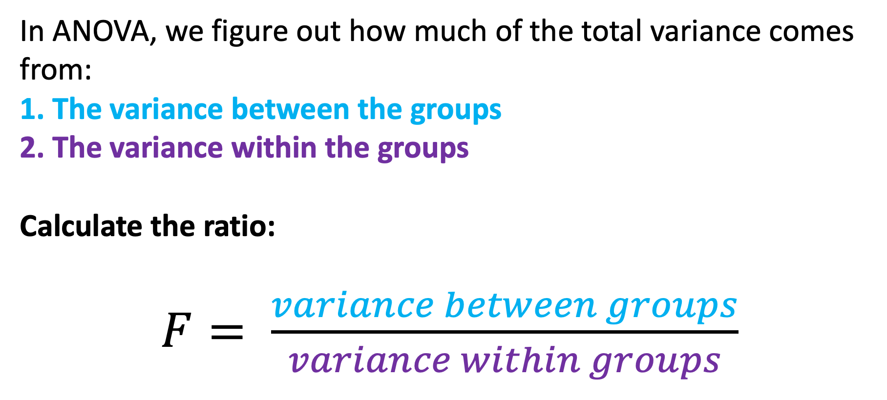
Analysis of Variance Examples
In ANOVA, we figure out how much of the total variance comes from:
1. The variance between the groups
2. The variance within the groups
Calculate the ratio:
$F= \frac{variance between groups}{variance within groups}$

Slide 18
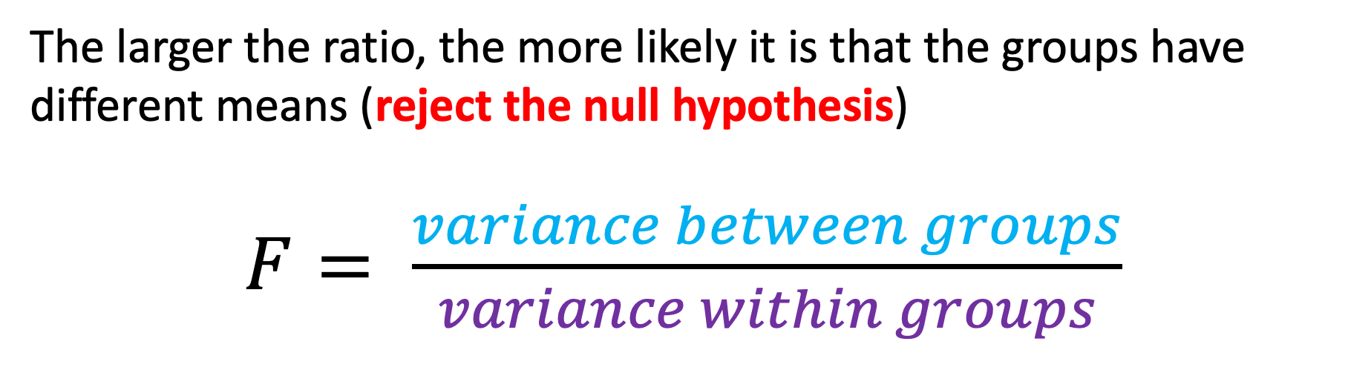
Analysis of Variance Examples
The larger the ratio, the more likely it is that the groups have different means (reject the null hypothesis)
$F= \frac{variance between groups}{variance within groups}$

Slide 19
Analysis of Variance Examples
Water | Juice | Coffee
29 | 28 | 25
30 | 29 | 28
31 | 27 | 29
31 | 30 | 27
29 | 29 | 29
In this case, the variance between and within groups is not so obvious. You probably cannot tell if there is a significant effect because its not clear whether there is more variance between or within groups or how much.

Slide 20
Analysis of Variance Examples
Water | Juice | Coffee
29 | 28 | 25
30 | 29 | 28
31 | 27 | 29
31 | 30 | 27
29 | 29 | 29
$$F= 4.27$$
$$p=0.4$$

Slide 21
Analysis of Variance Examples
Water | Juice | Coffee
29 | 28 | 25
30 | 29 | 28
31 | 27 | 29
31 | 30 | 27
29 | 29 | 29
The calculation for this example shows that the ration is 4.27 with a p-value of 0.04. In this case, we cannot reject the null hypothesis
With this example, the drink you give does have an effect on reaction time.

Slide 22


Multiple Variables
 | Water | Juice | Coffee
Morning | 30,31,31, 32,32 | 28,30,27, 29,32 | 25,26,25, 28,29
Evening | 31,31,33, 35,30 | 29,30,28, 29,31 | 28,30,27, 26,27

Slide 23
Summary
The main idea of ANOVA is to figure out how much of the total variance comes from:
The variance between the groups
The variance within the groups

Slide 24
Summary
The main idea of ANOVA is to figure out how much of the total variance comes from:
The variance between the groups
The variance within the groups

Slide 25
Summary
Water | Juice | Coffee
29 | 17 | 10
29 | 18 | 11
30 | 19 | 12
31 | 19 | 12
31 | 20 | 13
If most of the variation is between groups, there is probably a significant effect.

Slide 26
Summary
Water | Juice | Coffee
10 | 11 | 12
12 | 14 | 13
18 | 19 | 17
24 | 23 | 25
36 | 38 | 37
If most of the variation is within groups, there is probably not a significant effect.

